Slide 1

Is it possible to predict a hotel's rating based on different characteristics?
Served by Michal Berlin
INTRO TO DATA SCIENCE

Slide 2
Data Acquisition:
At this stage, I need to get all the information and gather it into one file so that I can research the information and see what conclusions can be drawn from it.
My data source for this project is TripAdvisor website.
It contains a lot of information about hotels all around the world,
but I wanted to specifically focus on Greece.
The website offers info such as hotel price, hotel name, rating,
value rating, cleanliness rating, info about facilities of the hotel,
for example- pool, fitness center, spa, TV etc.
I acquire the information by crawling on the TripAdvisor website and saving the data into a DataFrame.
.

Slide 3

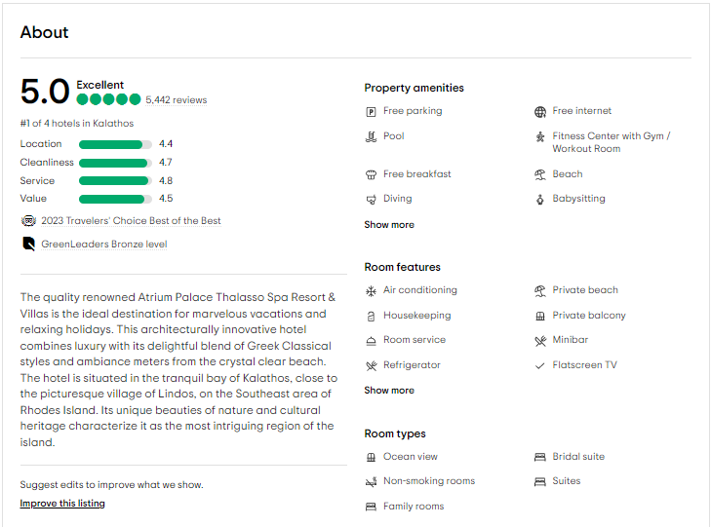
For example, a hotel from the website:

Slide 4

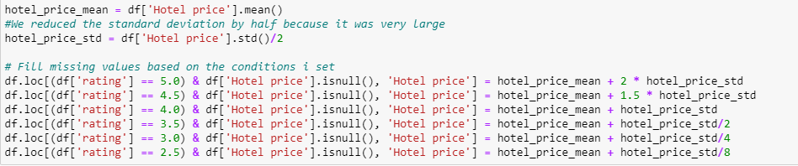
Cleaning:
Now, after scraping the data, it is required to go through the data frame and clean it of duplicates and empty data.
In addition to this, hotels that were taken without a price during the
scraping, to treat them I calculated the standard deviation and the average of
the hotel price and used a certain logic that says that the higher the rating,
the higher the price
Below is the calculation-

Slide 5
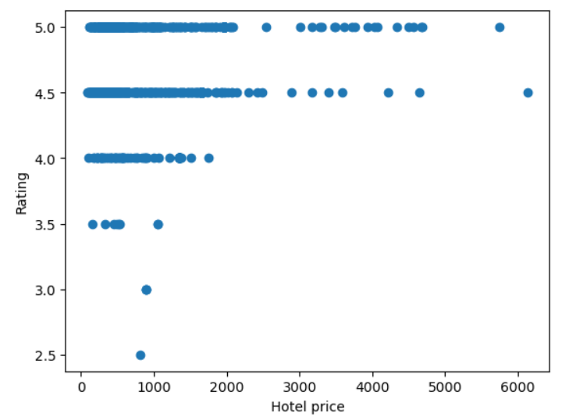
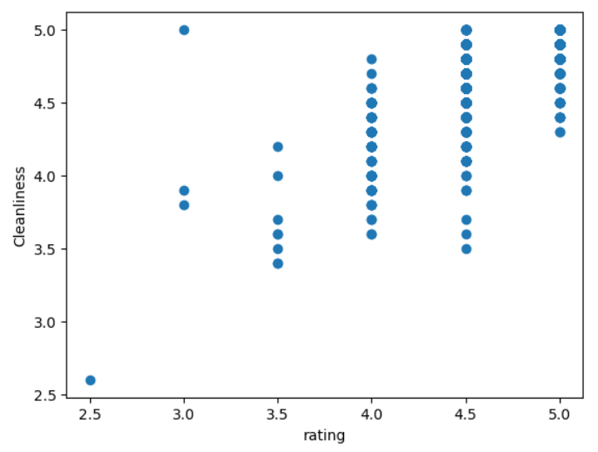
EDA:
On this part, I analyzed the data frame and drawed conclusions out of it based on the data.
Scatterplots that compare between various features of the DataFrame:

Slide 6
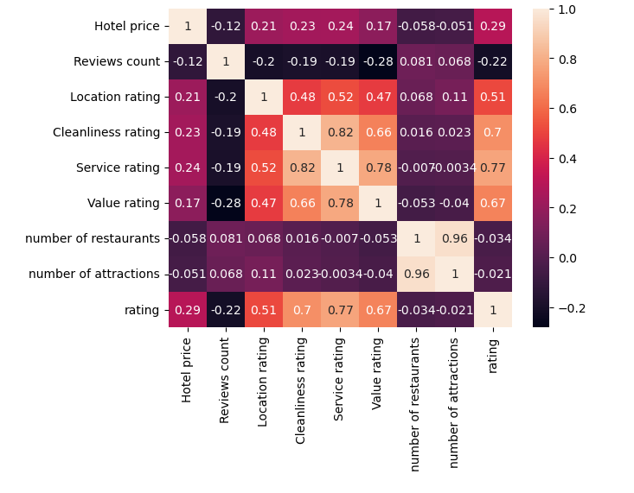
A table that shows the correlation between each feature in the data set
We can see that there’s correlation between “rating” and “cleanliness rating”,
“number of restaurants” and “number of attractions”, “hotel price” and “rating”.

Slide 7
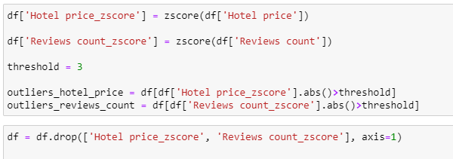
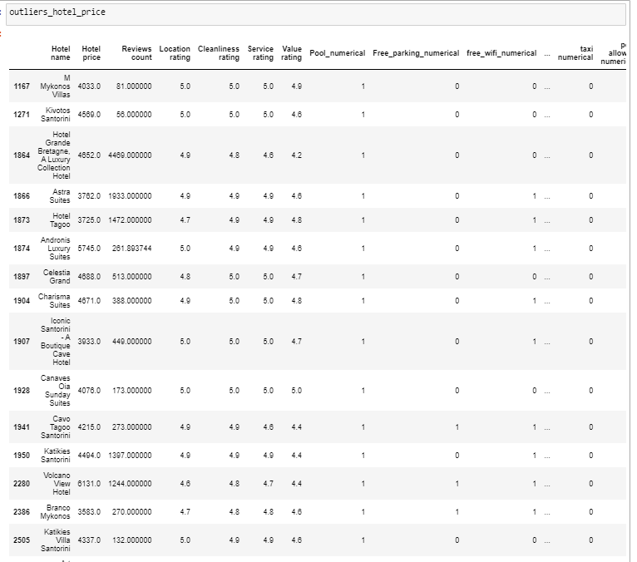
Handling the outliers
After scraping the data, I went through the data frame and discovered that there are outliers that harm the quality of the data and can harm the learning of the model later on.
For example - the price of a hotel is too high, or the number of reviews is too high.
The following is treatment of outliers: Example for some of the outliers:

Slide 8


Machine Learning:
At this stage we prepare the data frame before handing over to the various models, so that we can get a model as accurate as possible.
I chose to delete the hotel name column because using LabelEncoder would not contribute to my performance.
We used linear regression and a decision tree, and these are the results:

Slide 9
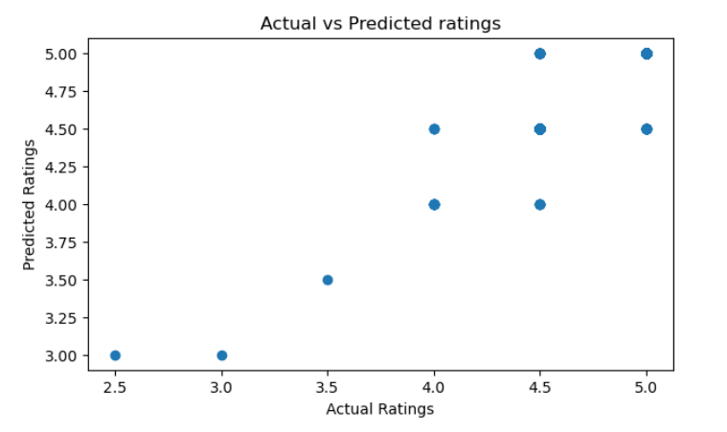
Conclusions:
Although most of the data in terms of the hotel's rating is not balanced (the ratings start from 2.5), we received good scores for the decision tree model with a 76% accuracy percentage
which were better than Linear Regression model, who scored 67%.

